Slide 1
Web Technologies
Lecture Week Three
Getting Started with CSS 3

Slide 2
This week’s agenda
Introducing CSS 3
Linking CSS and HTML together
CSS Selectors and its types
Vendor Prefixes
Pseudo Classes
Understanding Box Model
CSS Properties for Layout Designing

Slide 3
This week’s agenda
Building layouts for the web
Media Queries
Understanding Mobile first approach
Making your website responsive using media queries

Slide 4
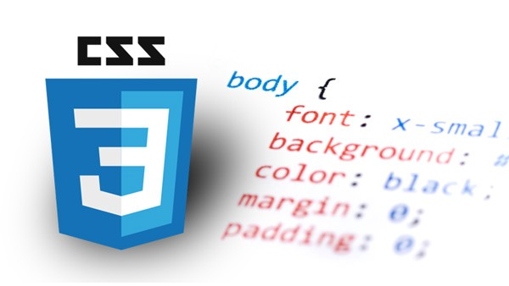
Getting started with CSS3

Slide 5
Getting started with CSS3…
CSS stands for Cascading Style Sheets.
It describes how HTML elements are to be displayed on screen or paper.
CSS can control layouts of multiple pages all at once ultimately saving lots of time.
It can be written in 3 different ways. - External: A CSS written in an external file and linked to HTML. - Internal: CSS written in the HTML file enclosed by a <style> tag. - Inline: CSS written as an attribute in the HTML element.

Slide 6
Getting started with CSS3
CSS is used to define styles for pages, including the design, layouts and variations in display for different devices and screen sizes.
CSS is also used to design layouts for mobile screens and tablets with the use of @media queries.
CSS syntax can be divided in to 3 parts. Selector, property and value. This is the standard way of writing css.
selector{ property: value; }

Slide 7
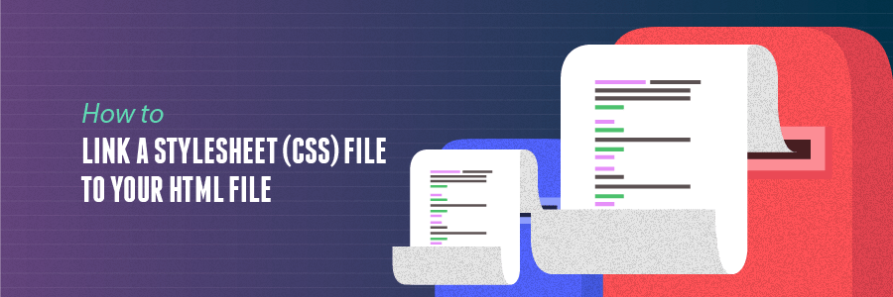
Link a Stylesheet

Slide 8
Linking CSS and HTML together…
As said before, CSS can be written in 3 different ways.
Inline CSS: Inline CSS is written directly into the html elements in a HTML document. This does not require you to import anything in the HTML document.
Internal CSS: Internal CSS is also written in the HTML document itself. However this is written inside a <style> tag and should always be placed inside the <head> element.
<div style=“border: 1px solid #000”>This has a border</div>
<style> div{ border: 1px solid #000; }</style>

Slide 9
Linking CSS and HTML together
External CSS: This is the standard way of writing CSS. Your every CSS codes should be written in a different file and needs to be saved with a “.css” extension. The saved CSS file is then linked to an HTML document using a <link> tag.
All three types of CSS has its own uses. The most correct way to write CSS is to create a new file (External CSS) and write all your styles in that file.
<link href=“yourcssfile.css” rel=“stylesheet”>

Slide 10
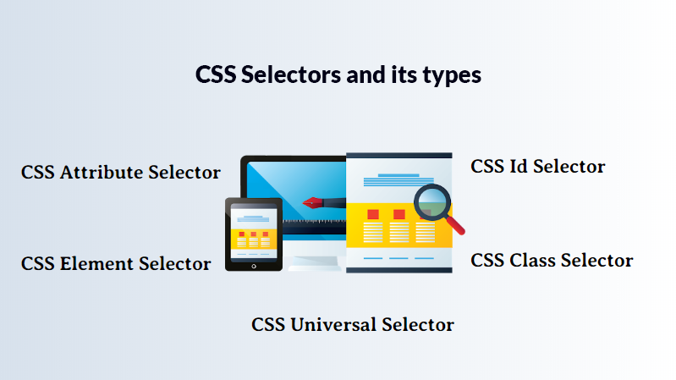


Slide 11
CSS selectors and its types…
CSS selectors are used to target HTML element that we want to style.
A selector is a component of CSS declaration.
There are five varieties of CSS selectors. - CSS Universal Selector - CSS Element Selector - CSS ID Selector - CSS Class Selector - CSS Attribute Selector

Slide 12
CSS selector: Universal Selector
A universal selector selects all the elements in a web page.
We can declare an universal selector with the help of an asterisk (*).
Universal selectors can be used along with other selectors in combination but is highly discouraged to do it.
*{
color: blue;
font-size: 12px;
}

Slide 13
CSS selector: Element Selector
Element selector is also known as the type selector.
The selector in CSS tries to match the element of the same name in HTML document it is linked to.
The below example targets all the <ul> elements in a HTML document.
ul{
border: 1px solid #ccc;
font-size: 12px;
}

Slide 14
CSS selector: ID Selector
ID selector helps to select a HTML element that has been given an ID name.
The ID can be selected using a “#” symbol in the CSS.
ID selector matches every HTML element having an ID attribute with the value the same as that of the selector, without the hash sign.
<header id=“header”></header>
#header{
border: 1px solid #ccc;
font-size: 12px;
}

Slide 15
CSS selector: Class Selector
Class selector helps to select a HTML element that has been given a class name.
The class can be selected using a “.” symbol in the CSS.
Class selector matches every HTML element having a class attribute with the value the same as that of the selector, without the dot sign.
<div class=“container”></div>
.container{
margin: 0 auto;
width: 1200px;
}

Slide 16
CSS selector: Attribute Selector…
Attribute selector styles content according to the attribute and the attribute value mentioned in the square bracket.
No spaces can be present ahead of the opening square bracket.
Attribute selectors have different ways to match the values with the attribute key.
<input type=“text”>
Input[type=“text”] {
font-size: 16px;
line-height: 1.2;
}

Slide 17
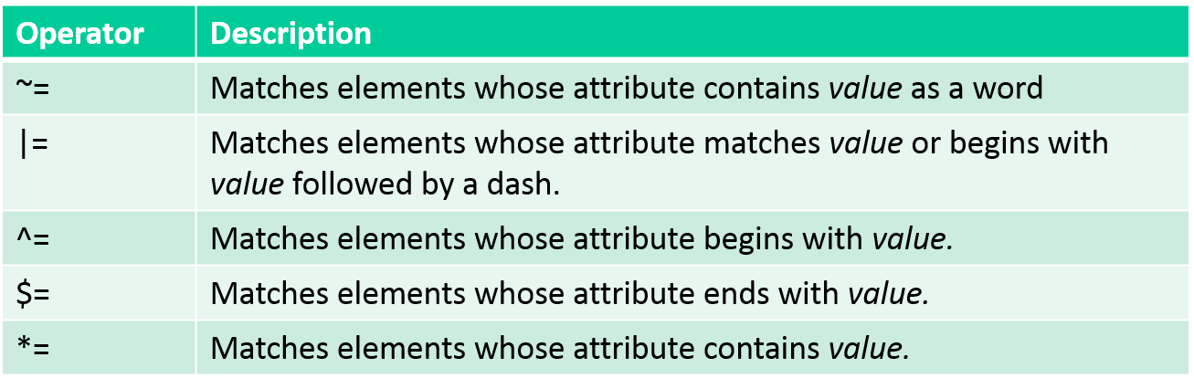
CSS selector: Attribute Selector…

Slide 18
Before you come for Lab, Research!!
Mozilla Developers Network: CSS
CSS: W3C Schools
CSS: Tutorial Points
CSS3: Tutorial Points
CSS Pseudo classes

Slide 19
Before you come for Lab, Research!!
Mobile First Approach
Responsive Web Design Breakpoints
Media Queries

Slide 20
Thank you!

